Slide 1
Bungee jump – use conservation of energy
E₁ = E₂ = E₃
h₁
Answers to depend upon mass and spring constant but not for free fall part of motion
free fall
max velocity at this position
h₂
e
cord
extending
For max velocity need
Bridge A: h₁ = 160 m e_{max} = 80 m
Put in numbers to find position at which max velocity occurs e, then find v_{max} from above equation, but to do this need values for m and k

Slide 2
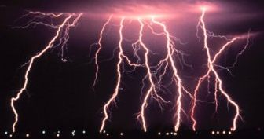
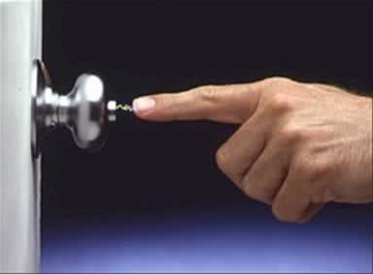
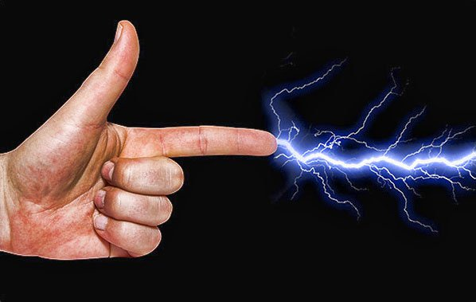
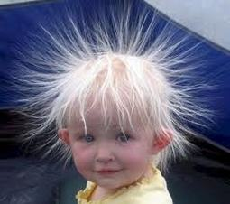
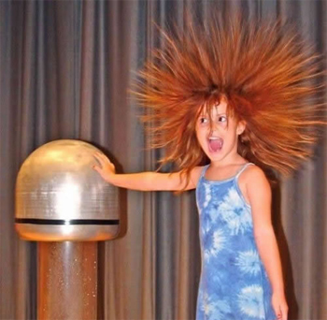
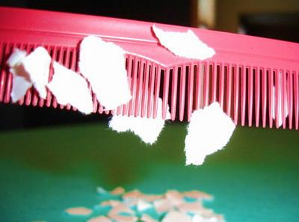
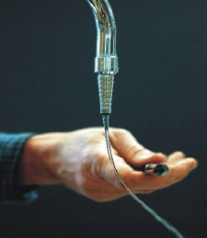
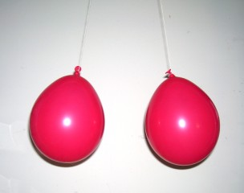
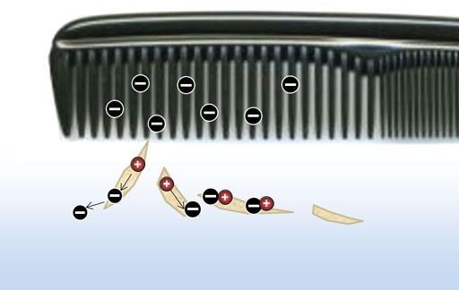
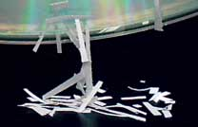
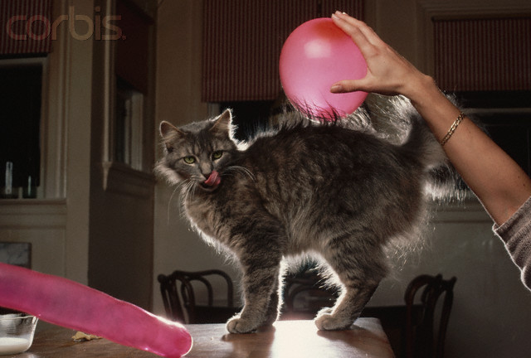
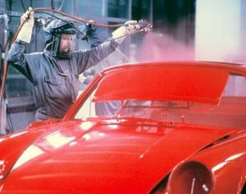
spark
van de Graaff
hair
repulsion

Slide 3
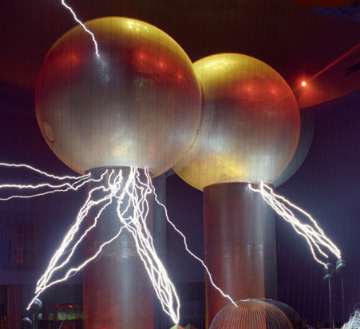

Slide 4
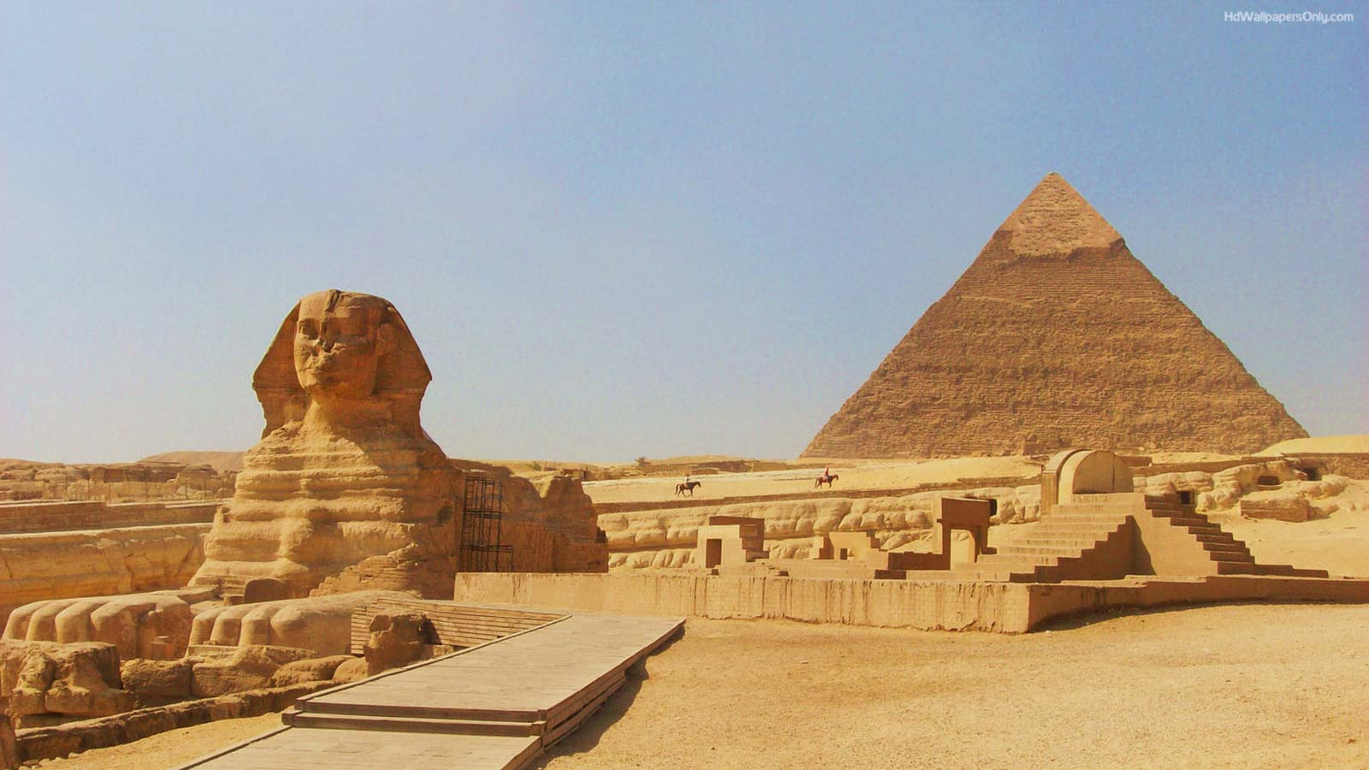
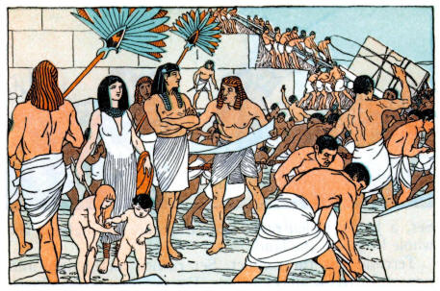
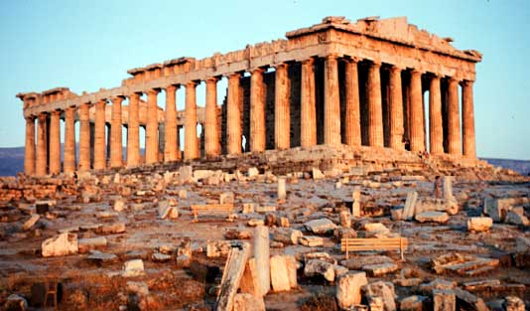

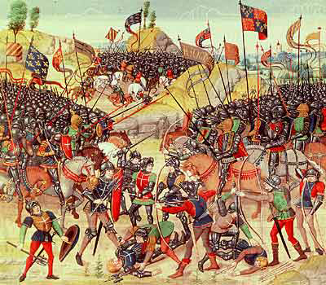
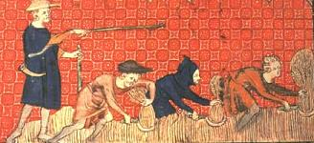

Slide 5
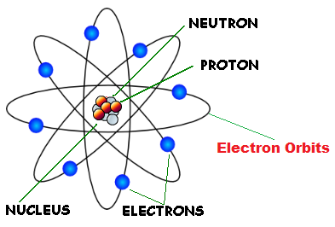
neutron
proton
electron orbits
nucleus
electrons

Slide 6
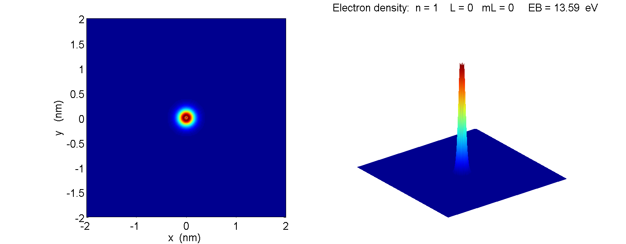
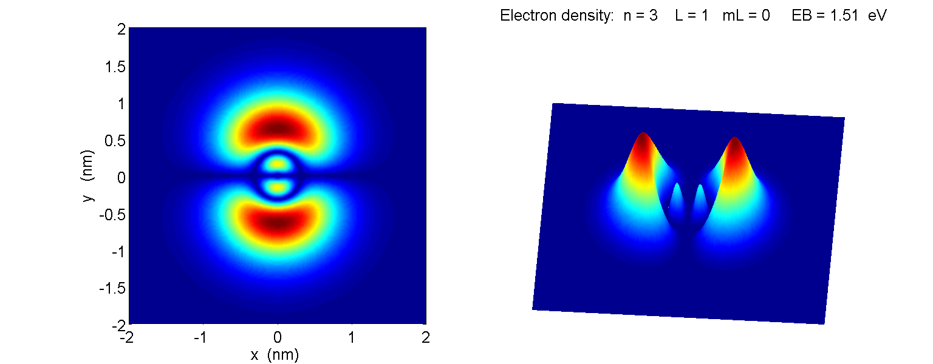

Slide 7
electrons ( - )
silk cloth ( - )
glass rod ( + )
woollen cloth ( + )
electrons ( - )
wooden rod ( - )

Slide 8
(1)
(2)
+ + + +
-
-
+
-
+
A
B
-
A
B
+
-
+
+
(3)
(4)
+ + + +
-
-
-
+
-
-
+
+
-
+
+
-
A
B
+
A
B
-
+
-
-
+
+
+

Slide 9
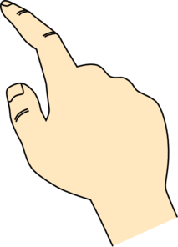
(1)
(2)
- - - - -
+
+
+
-
-
+
-
-
+
-
(3)
(4)
- - - - -
+
+
+
-
-
-
+
+
-
+
+
+
-
+
+
electrons move to the ground through finger

Slide 10
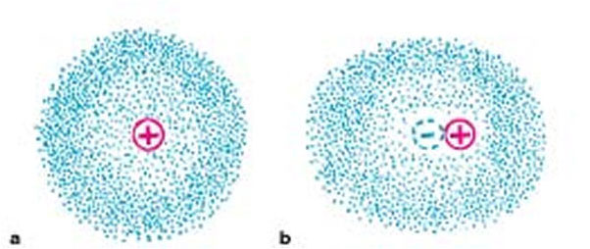
centres of positive and negative charges coincide
0
+ + + +
centres of positive and negative charges don’t coincide
+
distorted electron cloud -
atom is electrically polarized

Slide 11

+ -
+ -
-
-
-
-
+ -
+ -
+ -
+ -
+ -
+ -
+ -
+ -
+ -
+ -
+ -
wall: atoms become polarized
-
-
-
-
+
-
F_{repulsion}
F_{attraction}
balloon sticks to wall
F_{attraction} > F_{repulsion}

Slide 12

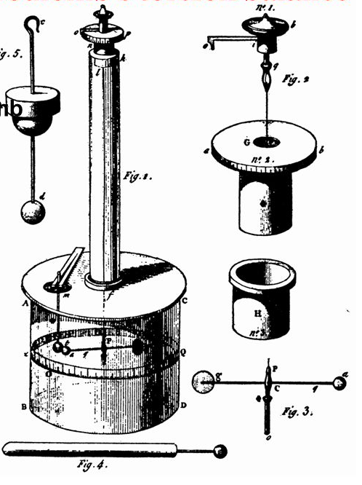
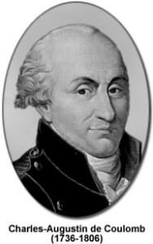

Slide 13
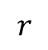
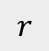
$$r$$
medium
$$r$$
vacuum

Slide 14

Y
$$r$$
X
Force of charge B on charge A
charges are of opposite sign, so, they attract each other
Force of charge A on charge B
Putting in the numbers
Newton’s 3rd Law

Slide 17
Y
C
X
Y
C
X

Slide 18
Y
X
C
30º

Slide 19
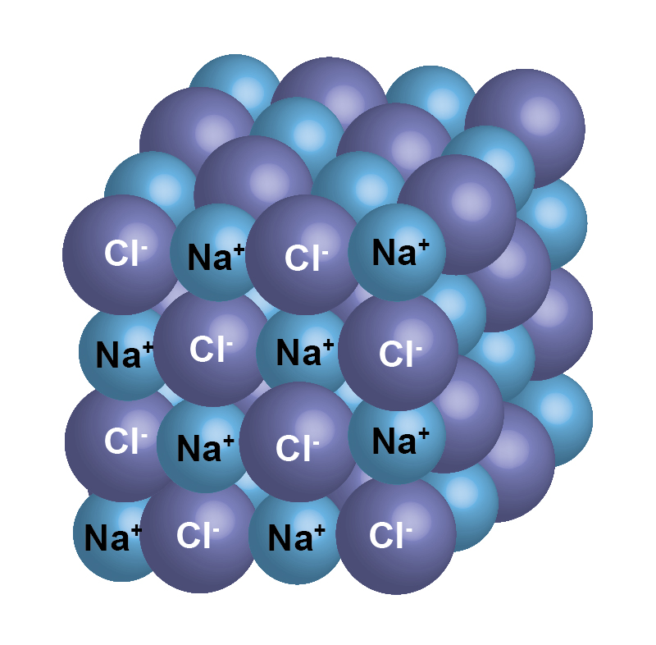
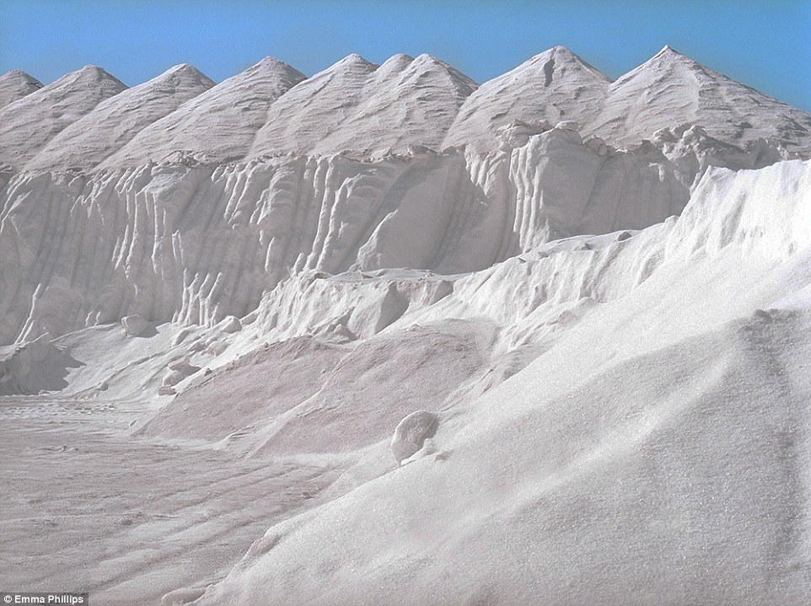
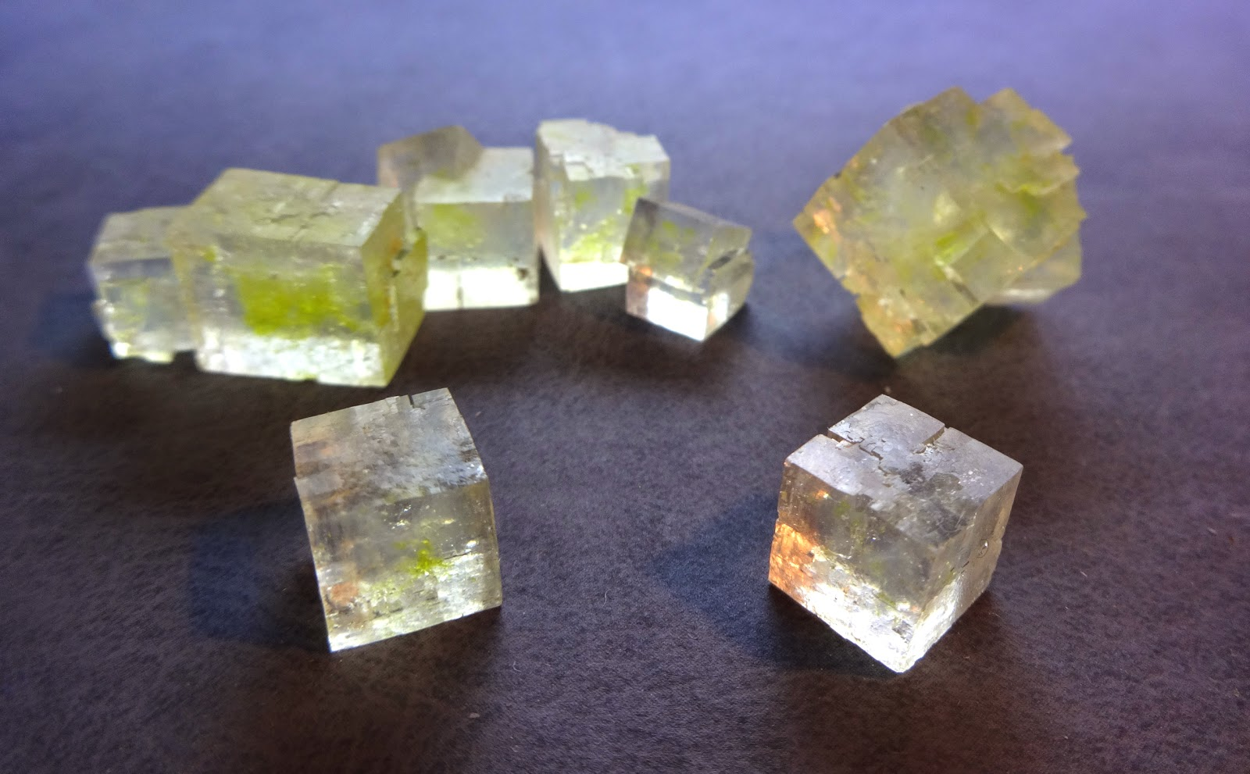
W.A. salt mine

Slide 20
Na⁺
Cl⁻
Cl⁻
Na⁺
Na⁺
Cl⁻
+
+
H₂O

Slide 21
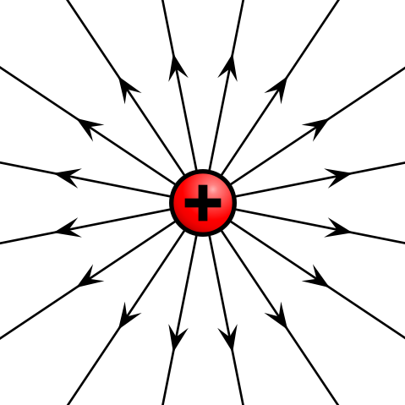
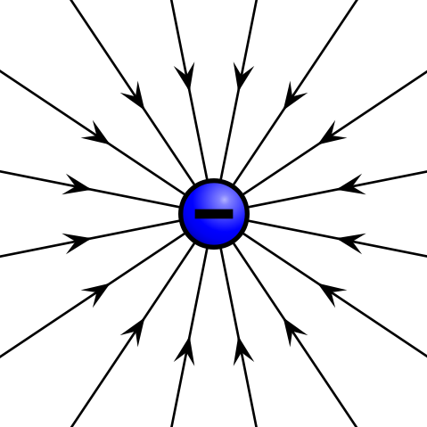
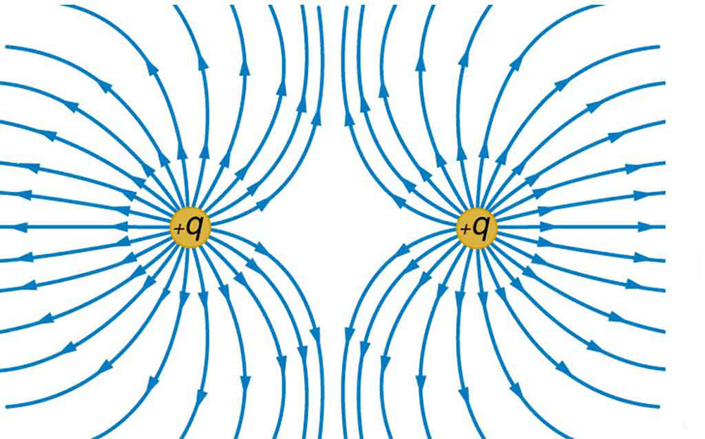
+
+

Slide 22
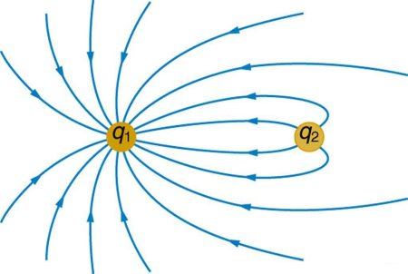
q₁
q₂

Slide 23
sphere 1
E large
sphere 2
E small

Slide 24
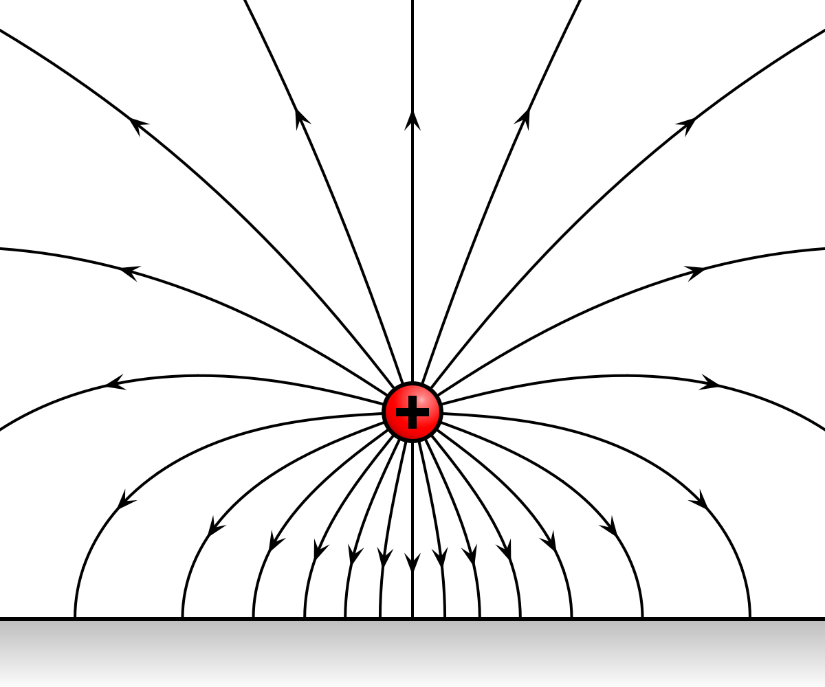
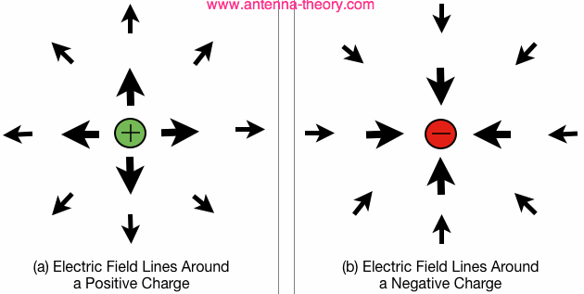
+
-
electric field
+ charge
electric field
- charge

Slide 25
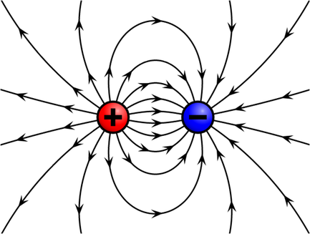

Slide 26
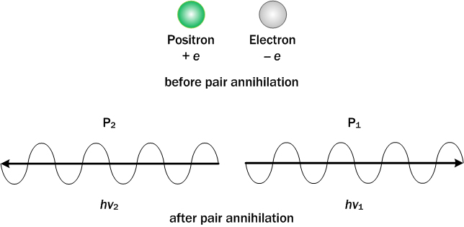
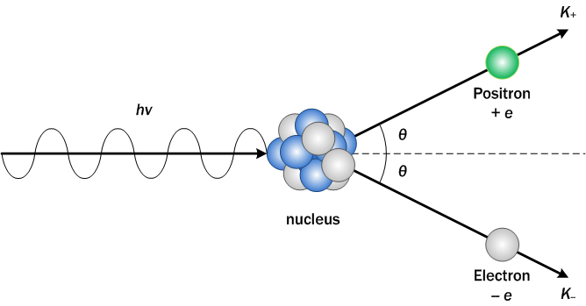
Annihilation
positron e⁺
electron e⁻
before pair annihilation
photon
photon
after pair annihilation
Pair Production
positron e⁺
photon E = h f
nucleus
electron e⁻

Slide 27
weak electric field
strong electric field
q > 0 vectors electric field and force are parallel
weak electric field
strong electric field
q < 0 vectors electric field and force are antiparallel

Slide 28
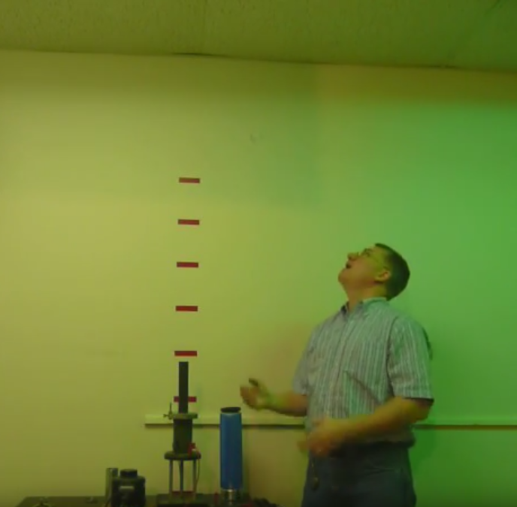
metal ring hit ceiling

Slide 29
+
++

Slide 30
+ + + + + + + + + + +
-
-
-
-
-
-
-
-
-
-
-

Slide 31

100 V
80 V
60 V
40 V
20 V
0 V
+
+
+
+
+
+
+
-
-
-
-
-
-
-
V
100 V
0 V
0
d
x
A
$$\text{B}$$

Slide 32
screen
Y
+ + + + + + + + + + +
X
-
-
-
-
-
-
-
-
-
-
-
parabolic path
straight line
path

Slide 33
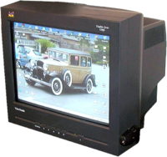
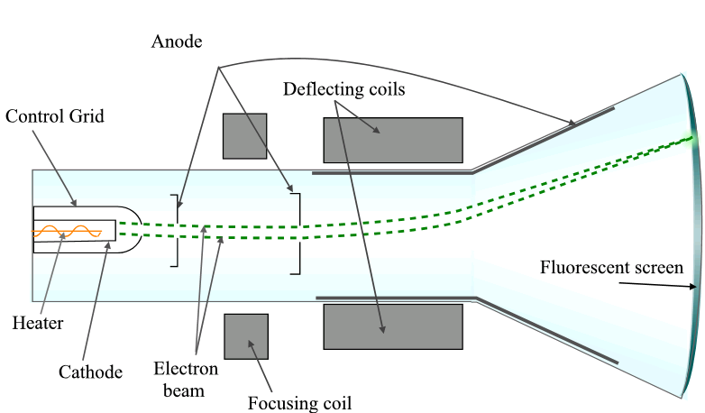
uniform electric field region

Slide 34
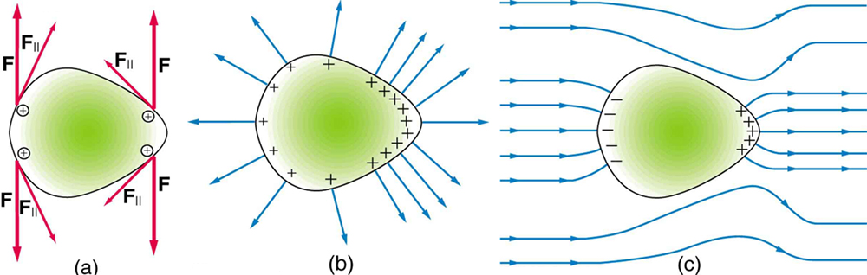
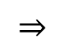
weak
electric field
strong
electric field
+
$$⇒$$
Free electrons move to the left because of the influence of the external electric field. Conductor becomes polarized, creating an internal electric field that opposes the external field.

Slide 35
+
+
+
+
+
+
copper wire
electron

Slide 36
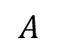
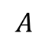
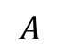
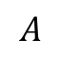
$$A$$
cross-sectional area [ m² ]
constant:
$$A$$
$$A$$
constant:
(0, 0)
$$A$$

Slide 37
charged particle density [ m⁻³]
number of charged particles of type c in volume element
volume V
+
+
+
+
+
charge on species of type c [ C]

Slide 38
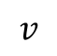
Conduction in a metal is due to the drift of free electrons
average drift velocity of electrons v [ m.s⁻¹ ]
N electrons in volume V
constant: A, q, n
(0, 0)
$$v$$

Slide 39
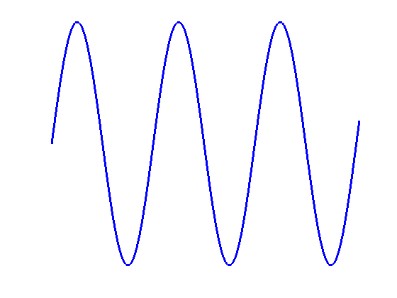
I
varying DC current
I
constant DC current
0
0
t
t
sinusoidal
ac current
I
ac current
I
+
+
0
t
0
-
-
t

Slide 40
uniform gravitational field
X
uniform electric field
+

Slide 41


Slide 42


Slide 43


Slide 44


recall image → other images
→ story line → drama title

Slide 45

Y
y [ m ]
X
3
#D y_{D} = 3 m
2
#C y_{C} = 2 m
1
#B y_{B} = 1 m
0
#A y_{A} = 0

Slide 46
+ + + + + + + + + + +
A
+
B
uniform
-
-
-
-
-
-
-
-
-
-
-
0 V

Slide 47
potentials w.r.t earth
earth
A + + + + + + + + + V_{A} = + 9 V
B + + + + + + V_{B} = + 6 V
C – – V_{C} = – 2 V
D – – – – – – – V_{C} = – 7 V
high potential
0 V
low potential
The potential differences between any two points is simply the difference in the potentials between the two points
V_{AB} = V_{A} – V_{B} = +9 - (+6) V = + 3 V
V_{BA} = V_{B} – V_{A} = +6 - (+9) V = - 3 V
V_{CD} = V_{C} – V_{D} = -2 - (-7) V = + 5 V
V_{DC} = V _{A} – V_{B} = +9 - (+6) V = + 3 V
V_{AC} = V_{A} – V_{C} = +9 - (-2) V = + 11 V
V_{CA} = V_{C} – V_{A} = -2 - (+9) V = - 11 V
V_{AD} = V_{A} – V_{D} = +9 - (-7) V = + 16 V
V_{DA} = V_{D} – V_{A} = -7 - (+9) V = - 16 V
Note: a potential difference exists when both points have the same type of charge. What is important is the extent of the charge imbalance.

Slide 48
high potential
low potential
+
current
positive charges
negative charges

Slide 49
+30 V
0 V
10 V
30 V
-10 V
30 V
10 V
20 V
-20 V
10 V
10 V
-30 V
0 V
-30 V
potential
differences
positive
potential
negative
potential

Slide 50
Y
+
X
high potential
A B
low potential

Slide 51


+
+
+
+
+
+

Slide 52

Mauna Loa Volcano Hawaii
height in feet

Slide 53
Y
X
y [m]
S(0, 0.5)
T(0.25, 0.5)
A(-0.5, 0)
O
+(0.5, 0)
x [m]

Slide 54
Two charges of equal
magnitude and same sign
-q
-q
Two charges of unequal
magnitude and opposite signs
+q₁
-q₂
Two charges of unequal magnitude and same sign
+q₁
+q2
[2D] quadrupole – four charges of equal magnitude and alternating sign lying on the corners of a square
-q
+q
+q
-q
[1D] quadrupole of 3 charges in a straight lines
-q
+2q
-q
Four equal charges at the corners of a square
+q
+q
+q
+q
A short capacitor model

Slide 55
T
S
T

Slide 57
Y
S
X
Y
attraction
negative
repulsion
X
S
positive

Slide 58
Y
+
-
X
The negatively charged object is attracted to the positive plate.

Slide 59
A
B
+
+
+
+
net attractive force between the two spheres A and B

Slide 60
+
B
+
+
C
A
net force on A

Slide 61
?
+
+
0.10 m
0.10 m
+
C

Slide 62
Y
electron
Direction of electric field is in the direction of the force that would act upon a positive charge
X
alpha particle

Slide 63
At each point, the direction of the force on a positive charge is in the direction of the tangent of the electric field line.
Y
X

Slide 64
constant force on negative charge
Y
uniform
electric field
X
constant force on negative charge
uniform
electric field
Y
X
parabolic path of negative charge

Slide 65
constant force on negative charge
Y
uniform
electric field
time
X
velocity
vectors
Negative charge moves in a straight line, parallel to the electric field direction. The negative charge falls with decreasing speed then stops and then rises with increasing speed due to its acceleration caused by the electrostatic force acting on it.

Slide 66
potential V
potential energy U

Slide 67




Slide 68

equipotential
A
B

Slide 69

Electric field and electric potential for a positive point charge
large slope implies large electric field
small slope implies small electric field
equipotential lines close together implies a strong electric field
equipotential lines across the electric field lines are right angles

Slide 70

hot filament

Slide 71
Y
uniform electric field between the plates
X
V [V]
(0,0)
30
+30.0 V
y [m]
+
-
-0.12
0.0 V
constant slope
constant electric field

Slide 72
Net charge resides on surface of conductor.
Electric field lines must be at right angle to surface of conductor.
weak
electric field
strong
electric field
+30 V
Earth neutral 0V
V is constant throughout the conductor

Slide 73
electrostatic force
electrostatic
potential energy
electric field
electric
potential
V

Slide 74
1000 V
800 V
600 V
200 V
400 V
0 V
G
A
B
C
D
E
F

Slide 75
1000 V
800 V
600 V
200 V
400 V
0 V
G
q=+2 C
+
E
A
B
C
D
F

Slide 76
electric field
Y
initial velocity
charge q < 0
X
electrostatic force
displacment
final velocity
The electrons moves from a lower potential to a higher potential point

Slide 77



Slide 78
uniform electric field
electron
proton
Newton’s Second Law
Displacement after time t
Kinetic energy
V_{e} = V_{p} = V

Slide 79


NO
YES
NO

Slide 80


